Slide 1
Capstone:
Topic Proposals
Matthew Garton
General Assembly Boston – DSI
September 20th 2018

Slide 2
1. Classification: Trading Signals
Rather than try to predict returns (time series model), re-frame the question into a classification problem:
  Will it move up or down?
  Will it move more or less than priced in?
One idea – apply image recognition technology to identify chart patterns, different shapes of volatility surface, etc.
Pros:
  Unique take on a challenging problem
  Achieves a middle ground/stepping stone b/w ‘old school’ trading and fully automated algorithm
Cons:
  Getting data for the things I want would be tough
  Image recognition?
  Clearly defining y variable (subjective?)

Slide 3
2. Classification: Portfolio Management Applications
Classify into one of a few discrete ‘regimes’:
  Stage of economic cycle
  High or low volatility regime
  ‘Risk-on/risk-off’
  Trend or range
Application: Use the classification to make passive asset-allocation decisions, or to choose a trading strategy.
Pros:
  Work with lots of different data, room for creativity
  Unique application, room for creativity
  Personal interest
Cons:
  Possibly very difficult
  Scope is very broad

Slide 4
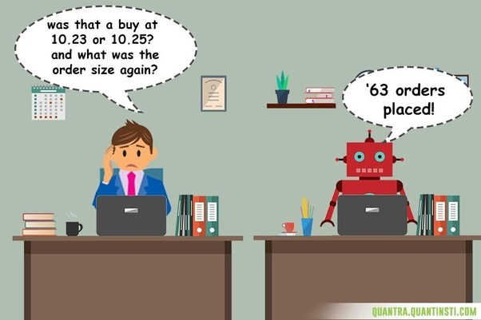
3. Business Problem
Build a trading algorithm
Pros:
  Platforms/infrastructure exists to get started; data easily available and implementation streamlined
  Personal interest – this is something I actually want to do
  I have domain knowledge
Cons:
  Not well defined
  Too ambitious?
  Time series data is tough
  to work with
  Appropriate for GA project?

